Slide 1
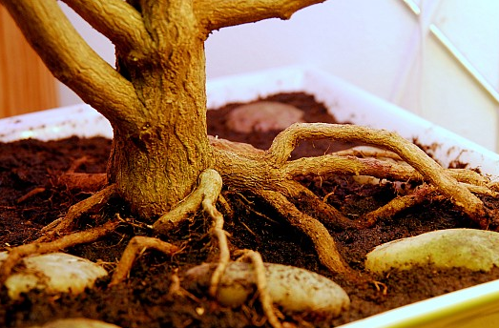
Roots and Stem Station

Slide 2
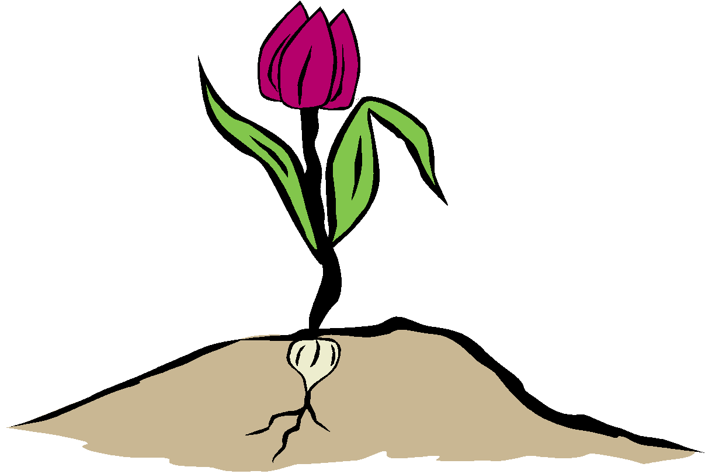
Look at this picture.
flower
leaves
stem
roots
Can you label the parts of the plant?

Slide 3
What is the function of the root?
The roots hold the plant in the ground and absorb water & nutrients from the soil.
root

Slide 4
What is the function of the stem?
The stem helps to support the plant by holding it upright above ground.
The stem also contains tiny tubes to transport the water & nutrients that was absorbed by the roots to other plant parts.
stem

Slide 5
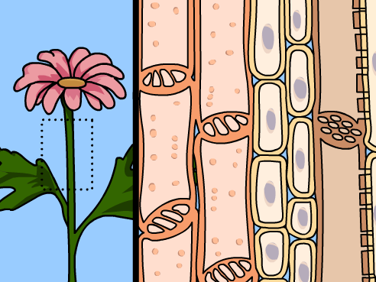
Brainpop Video on Plant Growth (2:27)

Slide 6
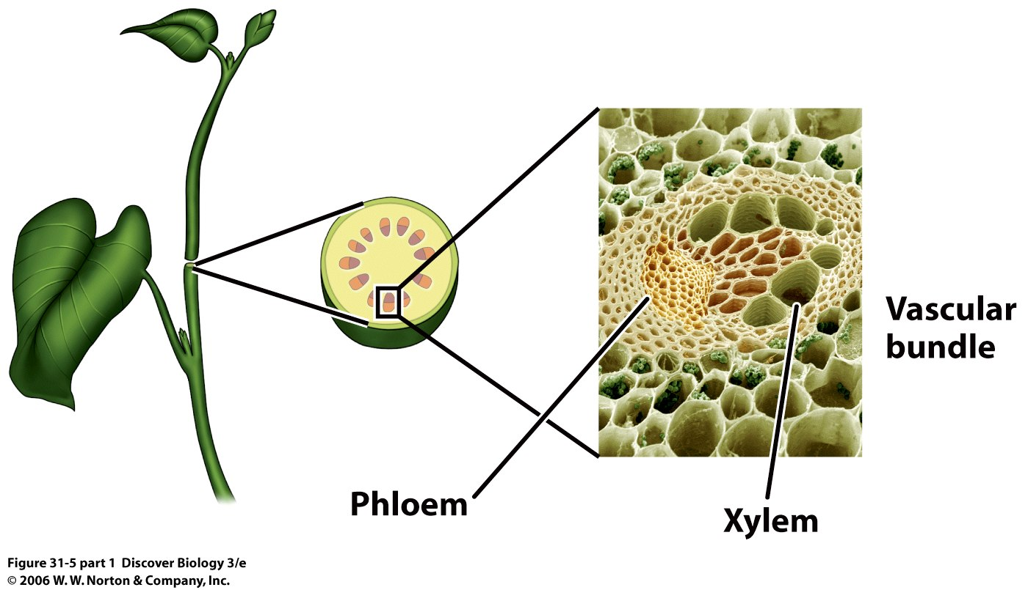

Slide 7
