Slide 1
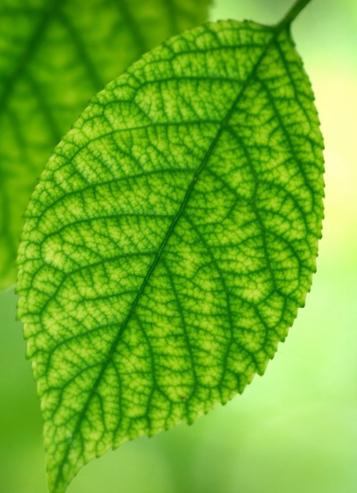
The Leaf Station

Slide 2
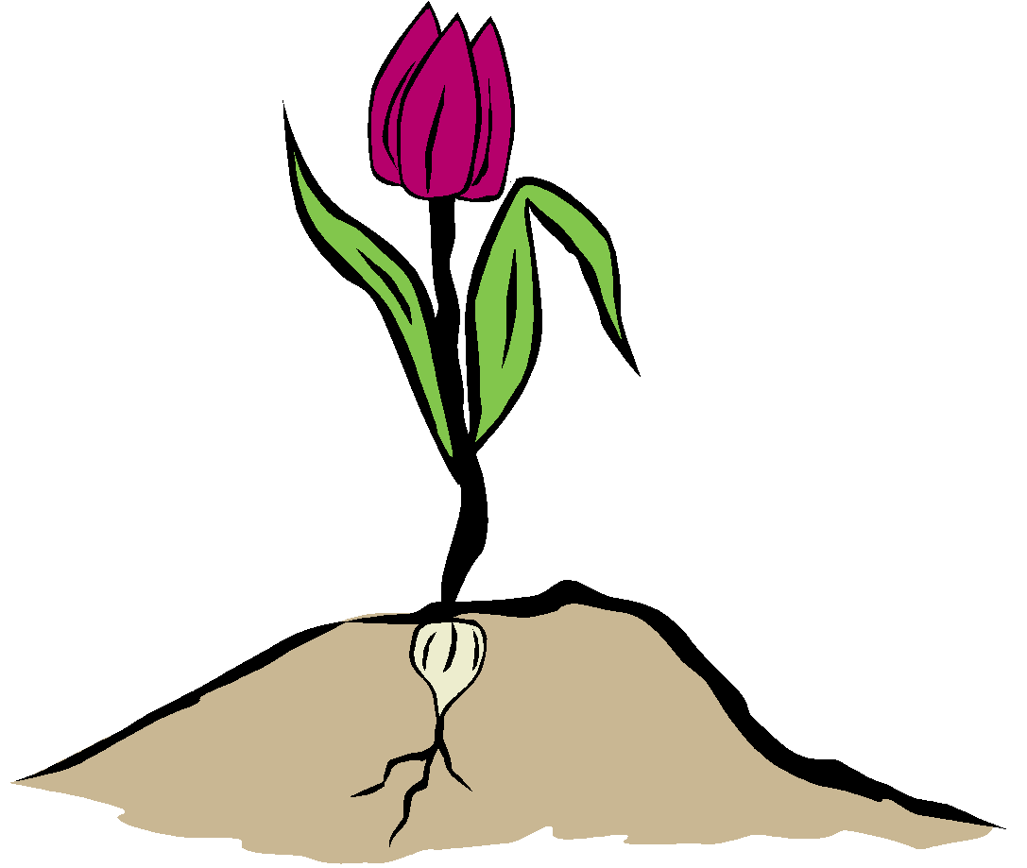
What is the function of the leaf?
Gas exchange takes place in the leaves
Photosynthesis takes place in the leaves.
Water storage is controlled by the leaves
leaf

Slide 3
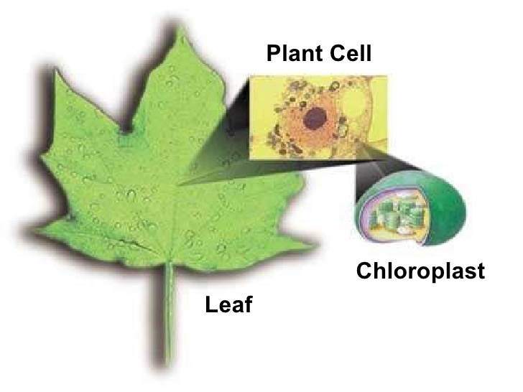
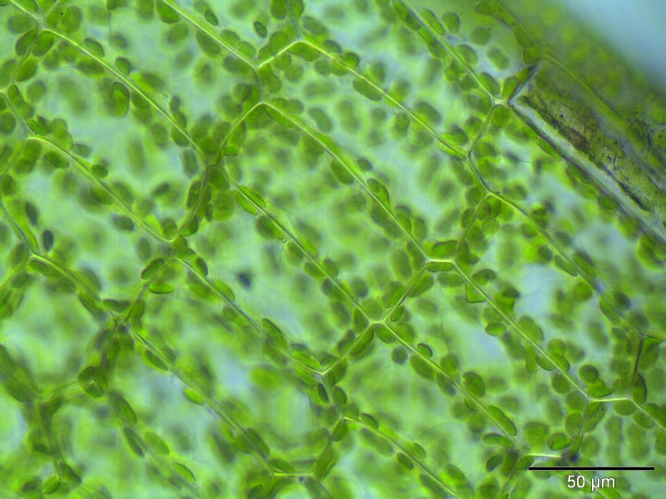
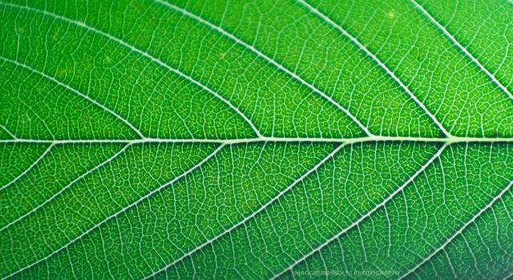

Slide 4
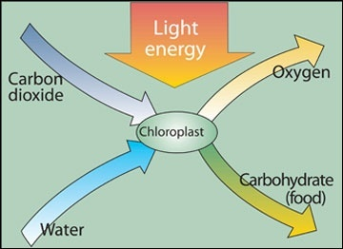

Slide 6
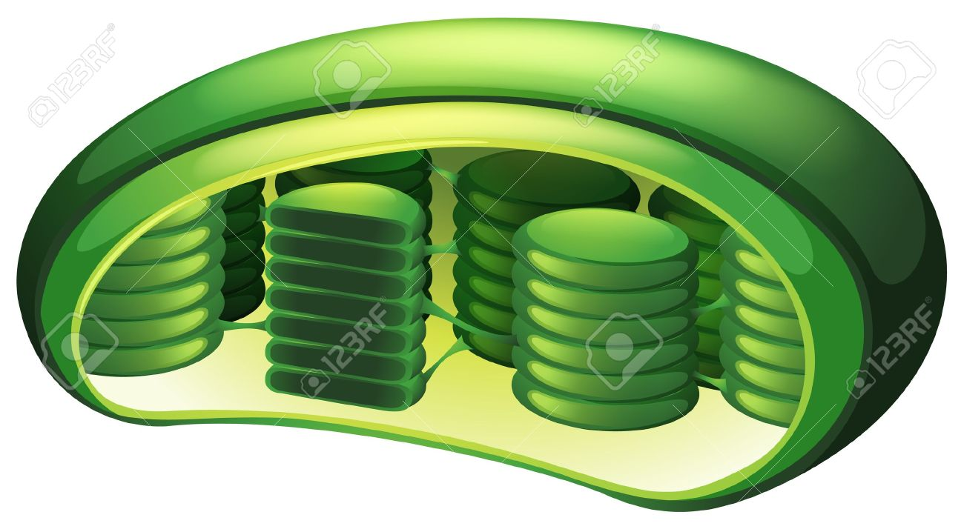
Chloroplasts
Location for the plants to turn sunlight into their own food.
contains the pigment chlorophyll that is used to absorb sunlight
it is chlorophyll that makes plants green!

Slide 7
What is photosynthesis?
Photosynthesis is the process where light from the sun is converted into food for the plant.

Slide 8
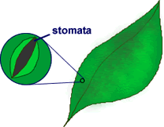
Stomata
Stomata – the pores in the plant’s skin that absorb/release water and allows the exchange of gases.

Slide 9
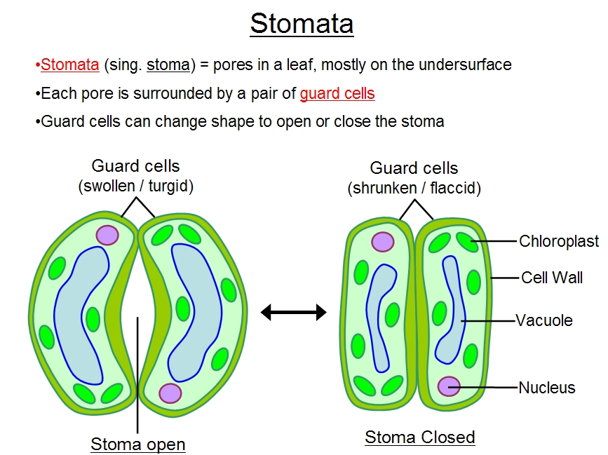

Slide 10
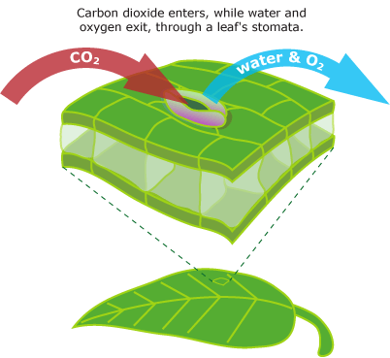

Slide 11
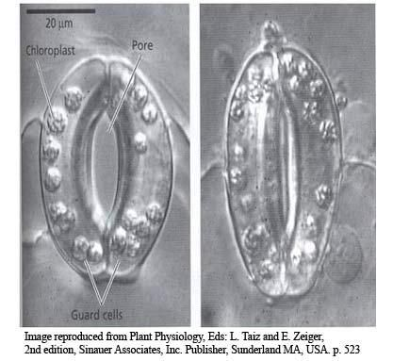

Slide 12
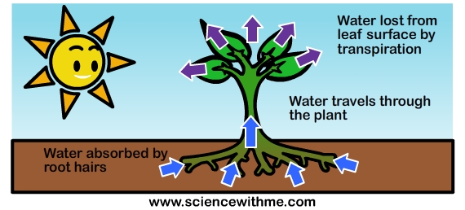
What is transpiration?
Transpiration refers to the gain or loss of water from plants

