Slide 1
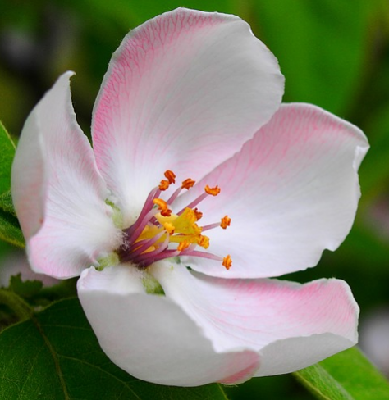
The Flower Station

Slide 2
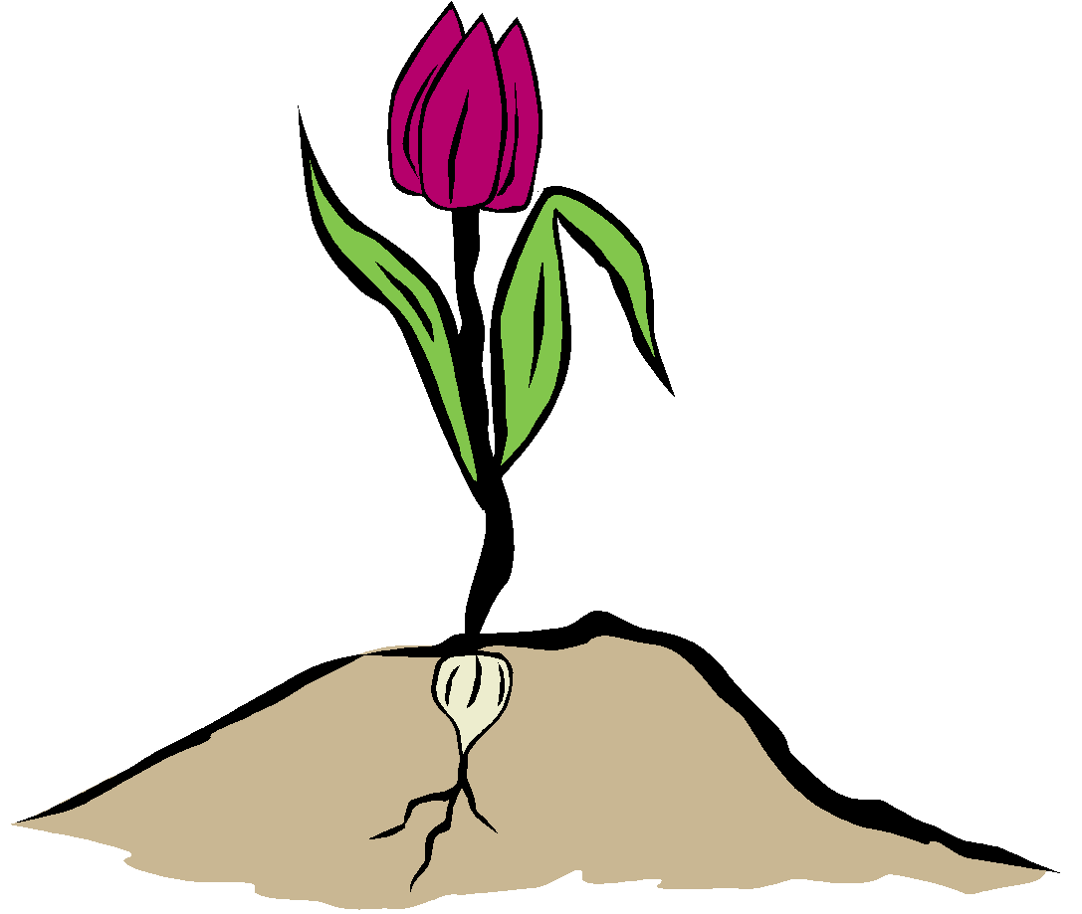
What is the function of the flower?
The flowers/petals are the colored parts of the plant. The flower is what attracts other organisms to the plant which in turn, helps the plant to reproduce.
flower

Slide 3
Flowers, Fruit and Seeds
When a plant receives the proper amount of water, nutrients, air and sunlight it produces flowers. The flowers usually grow on the stems. When the flower dies and falls off it leaves behind a fruit. The fruit contains seeds. Fruits that we eat include apples, oranges, watermelons and tomatoes. Sometimes we let the seeds dry out and use them for food. Things like corn, peas and beans are examples of seeds that we eat. The seed is the part that grows a new plant. If we plant a bean seed we will get a plant just like the one that made the seed.

Slide 4
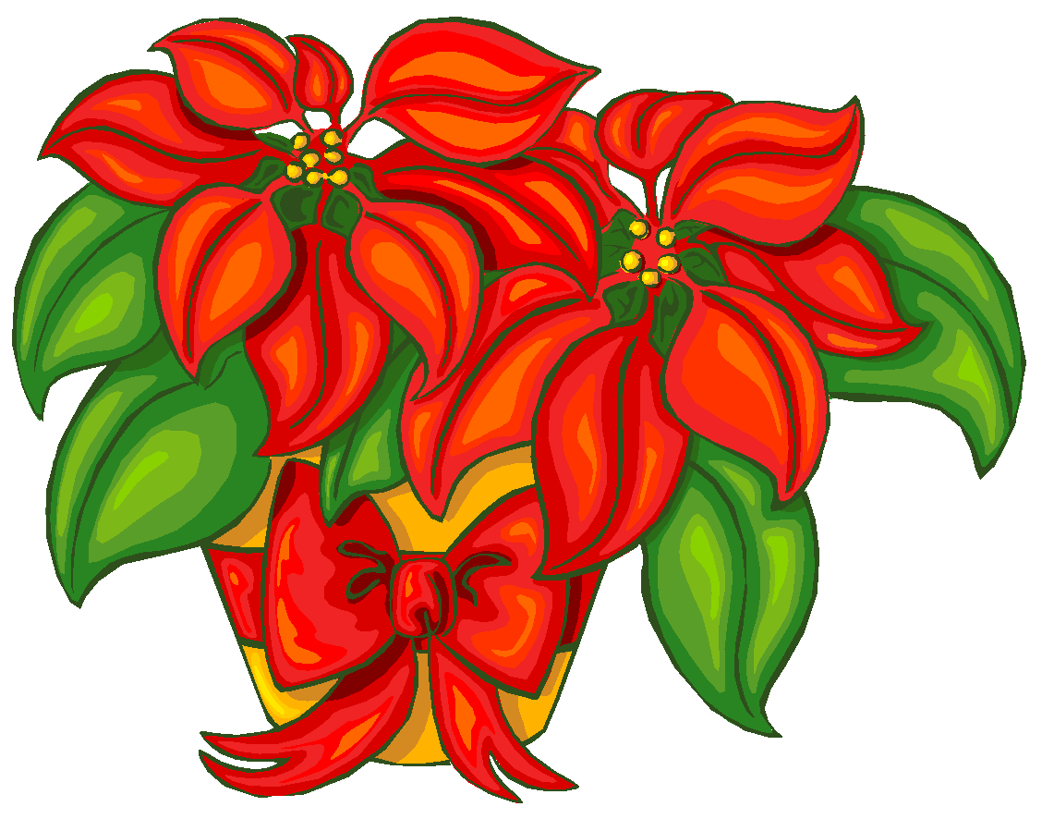
All PERFECT flowers have BOTH male and female parts
This is the name for the FEMALE part of the flower.
pistil
stamen
This is the name for the MALE part of the flower.

Slide 5
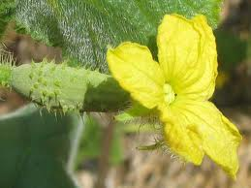
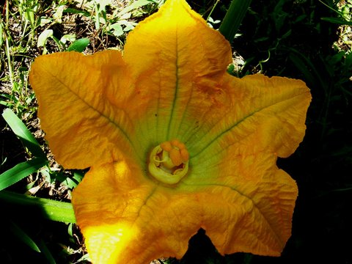
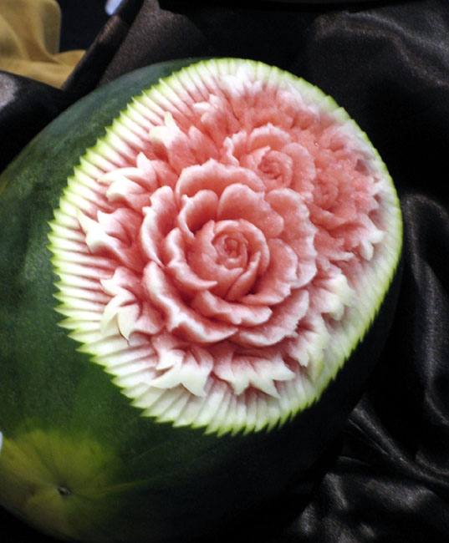
Some flowers are called imperfect because they may have only male OR female parts. Cucumbers, pumpkins and melons are often imperfect.

Slide 6
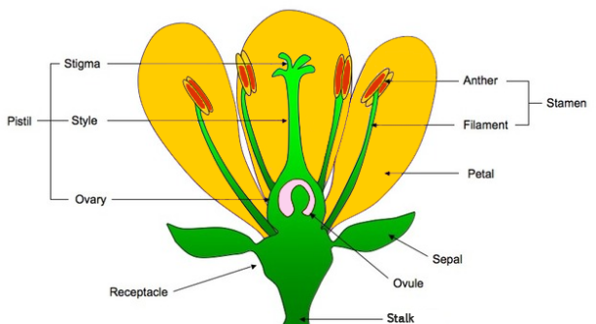

Slide 7
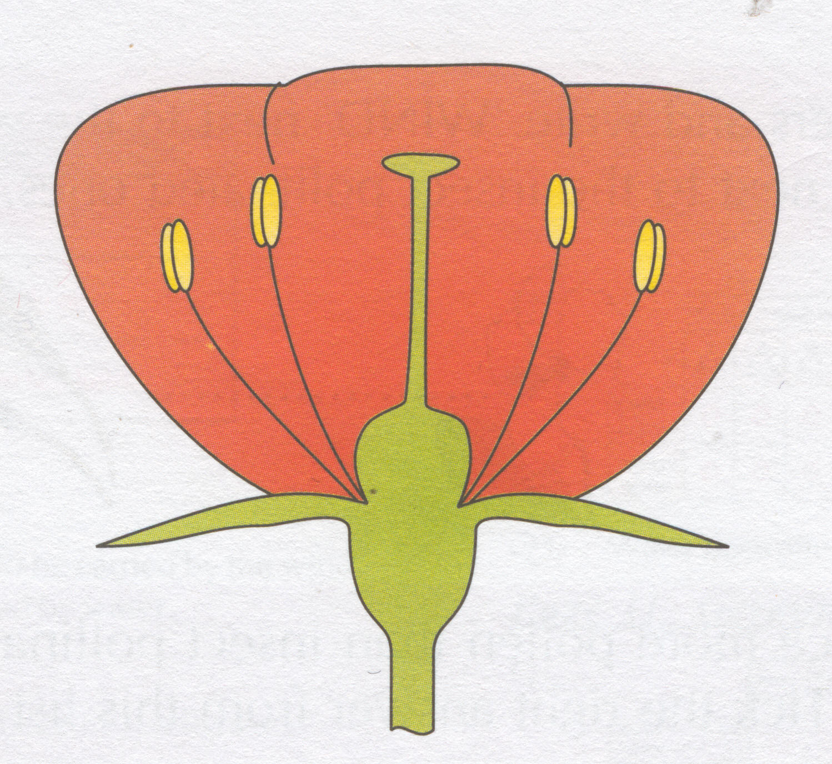
The pistil
(female part)
stigma
style
ovary

Slide 8
The stamen
(male part)
anther
filament
pollen

Slide 9
The parts of a flower
pollen
stigma
style
anther
ovary
filament

Slide 10
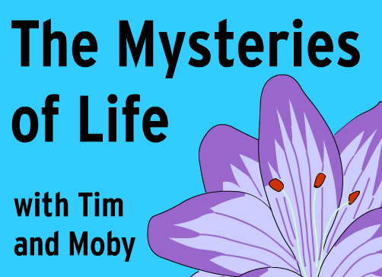
Brainpop Video on Pollination (2:25)

